Slide 1
The Purple Professor Project
Steven Luo
Evan Wu
Xiaoyun Chu
Jasmine Pena
Adnan Moheddin

Slide 2
Purple Prof Student Tracker
A web app to help professors manage and track their students.
Supports manual entry and CSV upload of students.
Search and filter by name, email, status, enrollment year.
Supports peer teacher management.
Statistics: total number of students, students in multiple classes, students average grade and QWF(Q drop, withdraw, failed) rate of each course

Slide 3
Initial Design
Layer | Tech
Frontend | Rails 8 with built-in templates
Backend | Ruby on Rails (MVC Architecture)
Database | PostgreSQL
Authentication | Devise + Google OAuth2
Deployment | Heroku
Version Control | GitHub

Slide 4
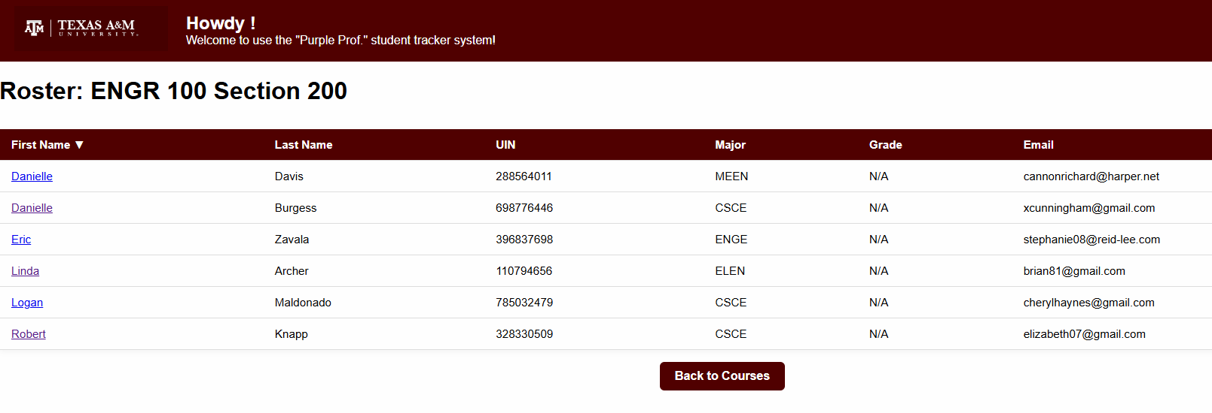
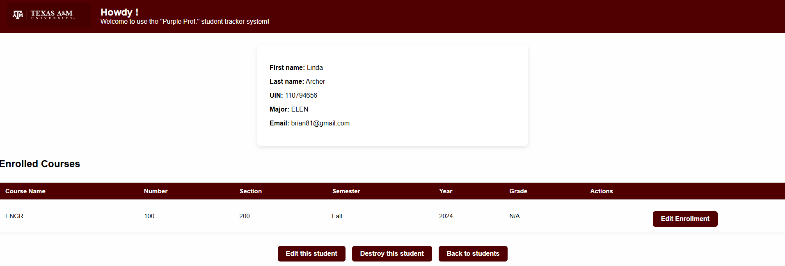
Feature: Student Rosters
Courses, Students, and Enrollments models
Add, delete, and edit for all models
Display all students in a course and sort by every category

Slide 5
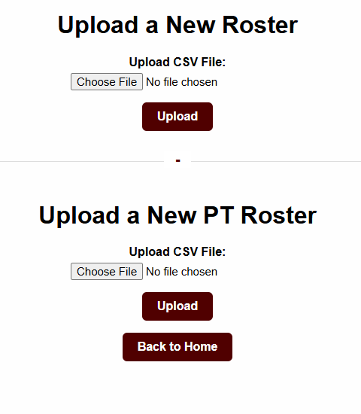
Feature: CSV Uploader
Upload a student or peer teacher roster for a course. This will automatically create student, PT, course, and enrollment models.
Separate functionality for individual students and PTs.

Slide 6
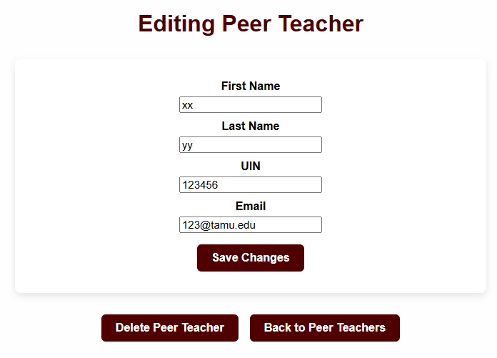
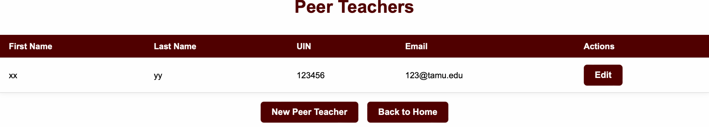
Feature: Peer Teachers
Add, edit, view, and delete Peer Teacher records
Details about full PT information

Slide 7
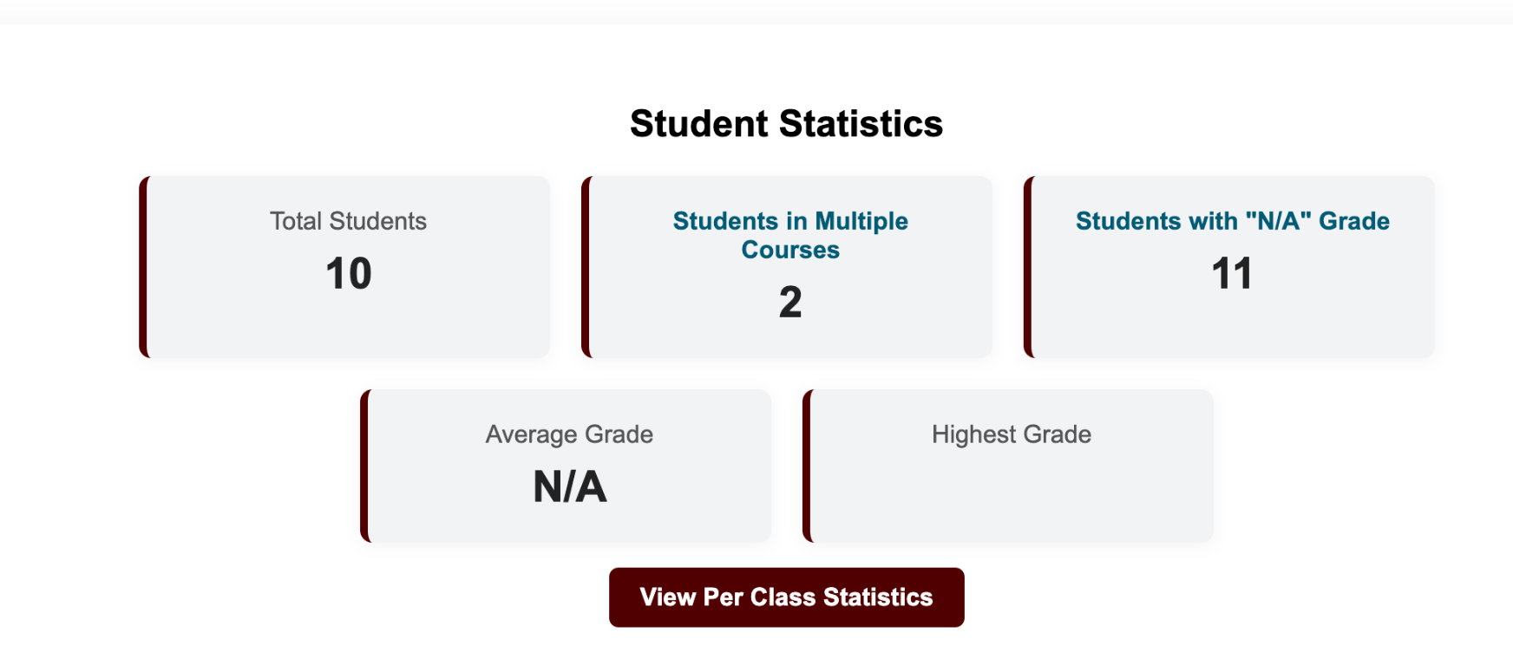
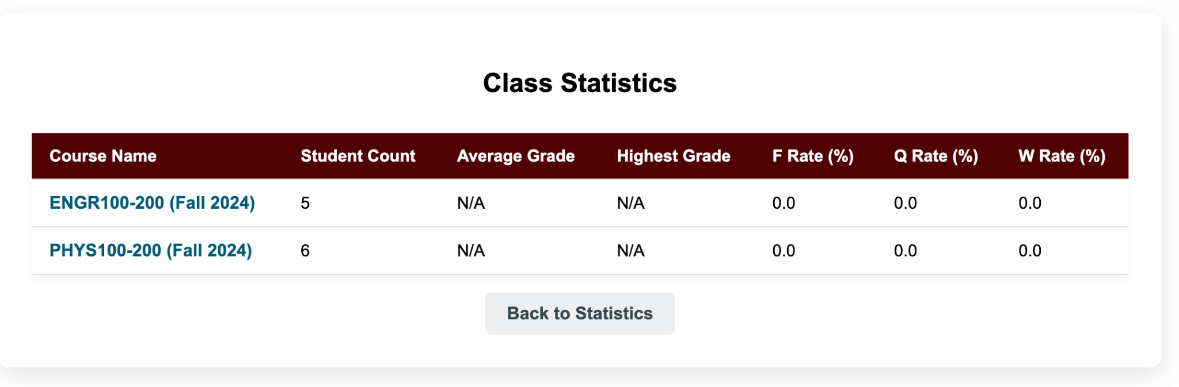
Feature: Statistics
Displays overall students
stats, including total number,average
grades,and missing grades.
By clicking “View per class statistics” reveals
Detailed breakdowns by course

Slide 8
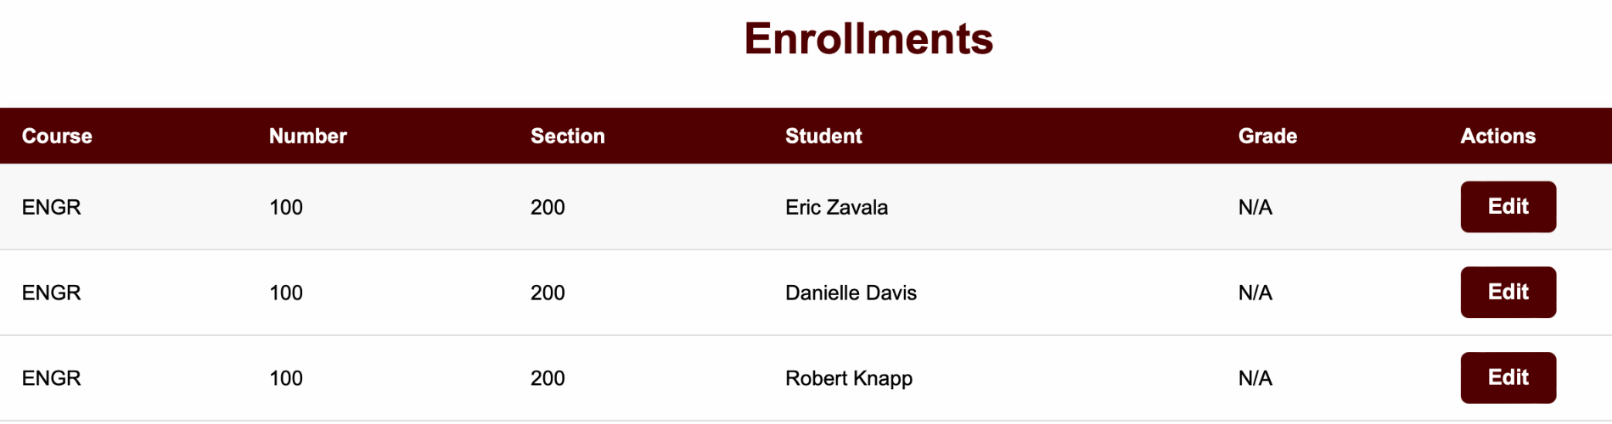
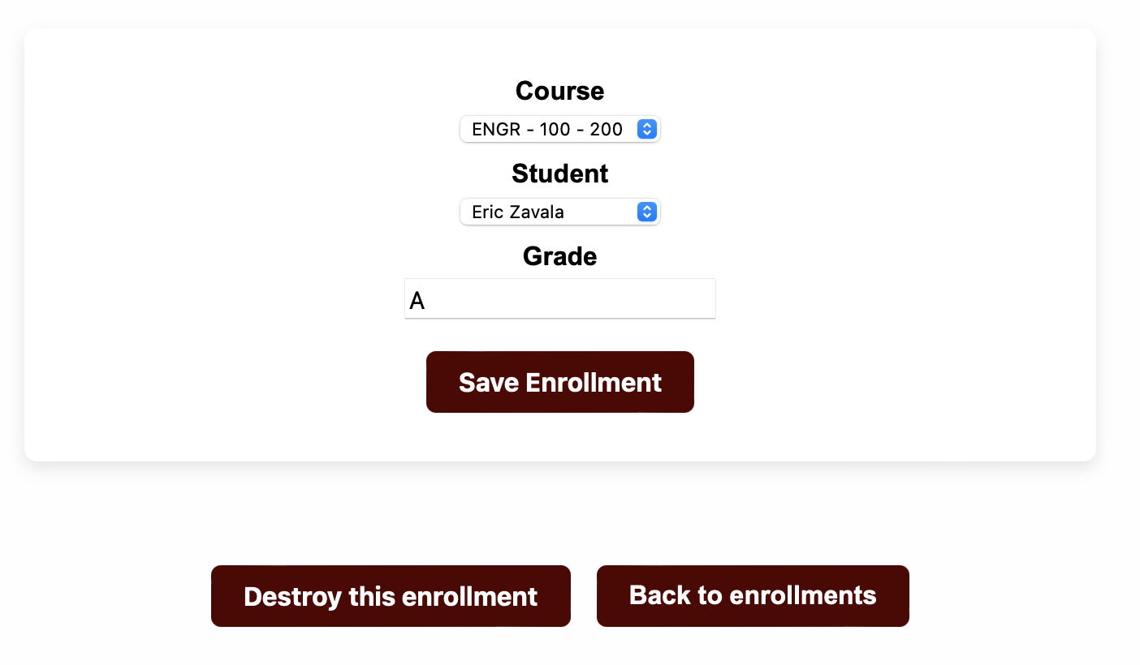
Feature: Enrollments
View/ Edit/ Destroy the enrollments
Display all enrollments, including course, section, students and grades

Slide 9
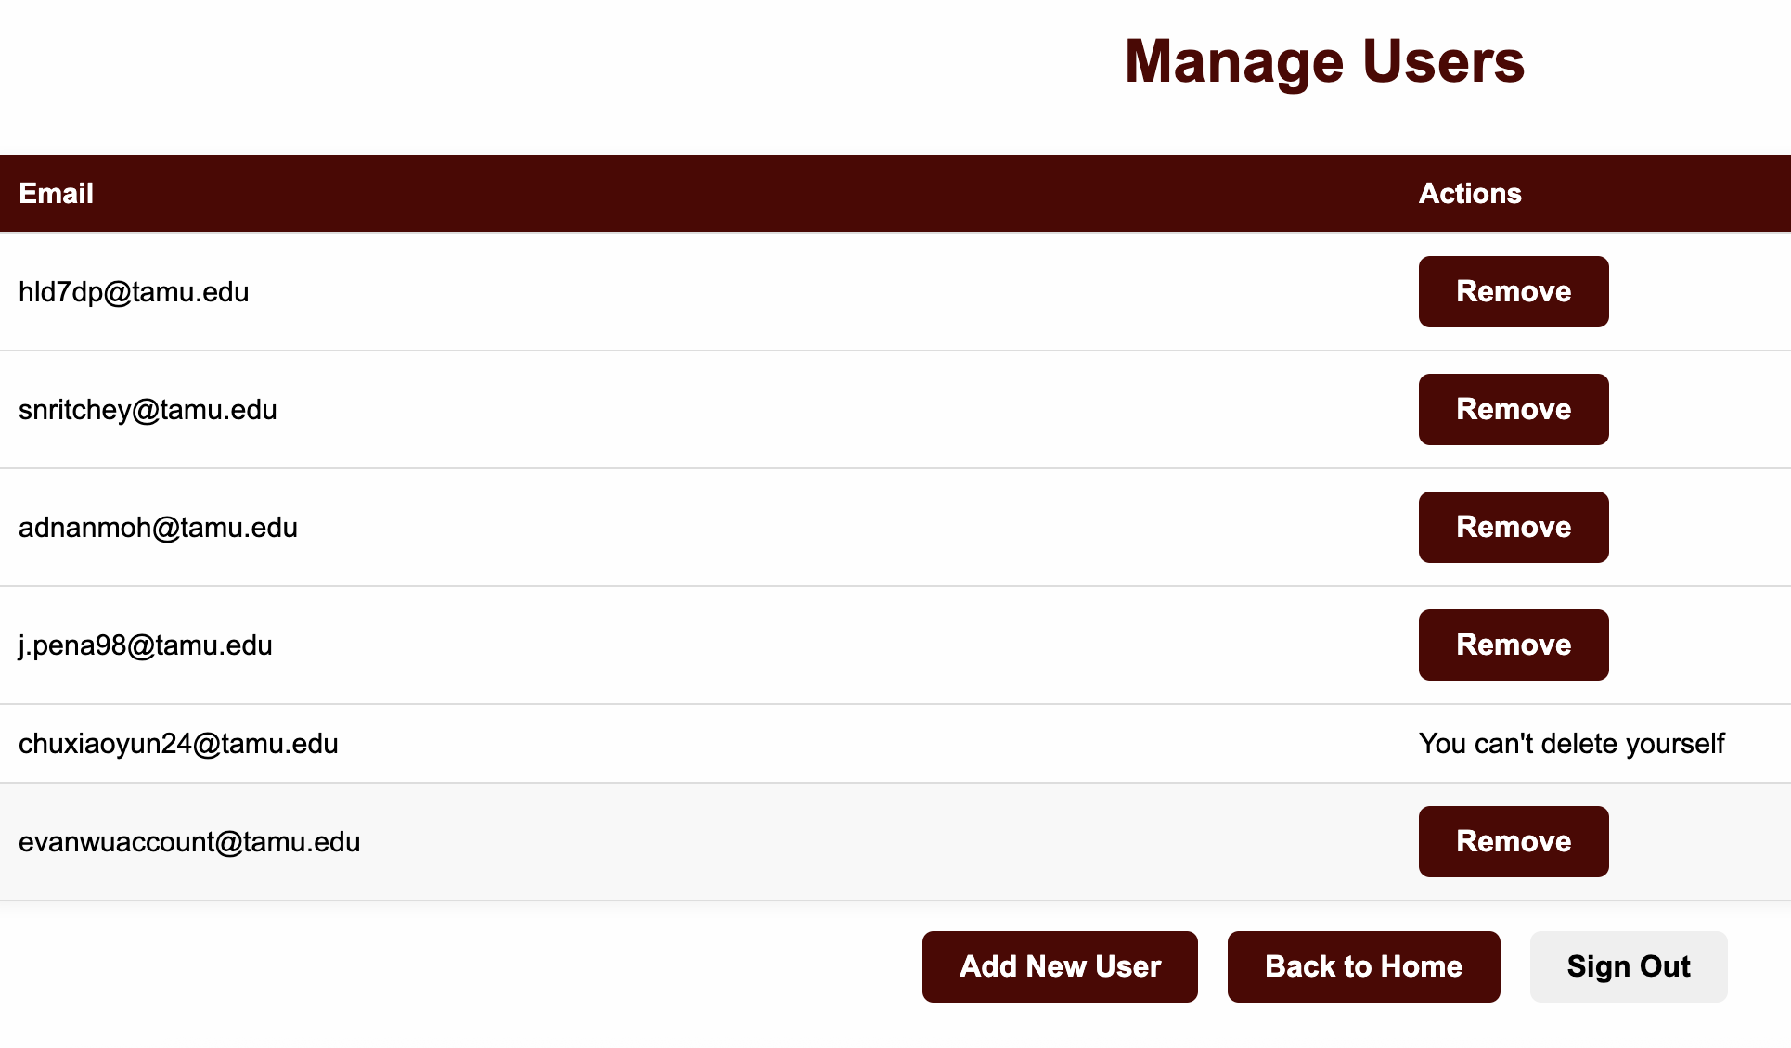
Feature: Users Management
Controls authorized login access to the system.
Admins can:
Add new users by email
Remove existing users (except themselves)

Slide 10
Challenges & Lessons Learned
Initial design is very important, we had to update our database design in the middle of the project due to poorly designed structure. This caused delays in development that pushed back our timeline.
Testing the app from a professor’s or user’s perspective helped us simplify the UI and prioritize useful features like grade statistics and easy CSV import.
Testing on Heroku early exposed issues we wouldn’t catch locally (e.g., production database config, missing add-ons,).
Smaller pull requests and modular controller logic made debugging and testing much easier.

